Slide 1
Subway Crimes
R Exploratory Data Analysis
Hyejin Kim

Slide 2
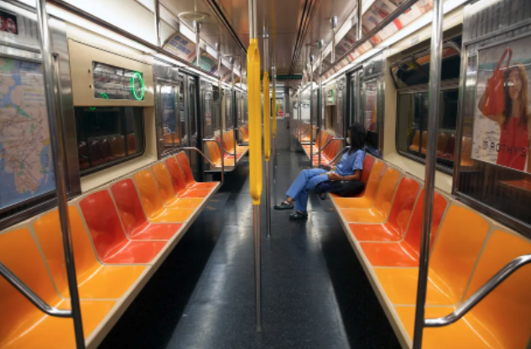
Dataset:
NYPD Complaint Data (2 tables)
MTA Daily Ridership Data (3 tables)
A commuter rides an empty 6 train in Manhattan, July 1, 2020. Ben Fractenberg/THE CITY
Notes:
Crime has gone up in recent years, with a lot of the issues stemming from post covid impacts.
It seems as though we hear or read about a different headline every week, particularly incidents that occured on the subway.
During the pandemic, while ridership was at an all time low, there was also an increase in homeless population setting up encampments in the subways and even on the tracks, with this increase there has also been increases in incidents related to mental health episodes, intoxication, and public endangerments
This dataset includes all valid felony, misdemeanor, and violation crimes reported to the New York City Police Department (NYPD)
Ridership data
All passengers who enter the subway system, including passengers who transfer from buses.

Slide 3
Annual ridership bar chart, Annual subway incident bar chart
Notes:
Shows magnitude of how much volume dropped vs. crime

Slide 4
Line graph, incident per ridership
Notes:
~60% increase

Slide 5
Line graph, incident per ridership for each borough
Notes:
Increase is evident in all 4 boroughs

Slide 6
Distribution of level of crimes per year per total volume
Notes:
Has there been an increase in serious crimes?

Slide 7
Distribution of level of crimes per year per total volume / For each borough
Notes:
Trend is similar across all boroughs

Slide 8
top 5 crimes somehow other than bar chart

Slide 9
Where do most of the crimes happen? Which stations? Was there a difference pre and post pandemic?
Show 2019 mapping and 2021 mapping

Slide 10
Differences in time of day when subway incidents occur?
Notes:
It seems like during the late night hours, there isn’t a big difference
Bigger gap in volume during the rush hours

Slide 11
Plots from prior slide seem to suggest that most crimes happen in busier subways, is that true?
Show incidents / ridership volume
Then show incidents per ridership / subway volume relationship

Slide 12
Lastly show range of ridership around 2 major incidents
April 12, 2022 - Frank James Subway shooting
January 15, 2022 - Michelle Go

Slide 13
Summary:
Next Steps:

